Slide 1

Web Software Automation Testing using Selenium, PyCharm and Python Robot Framework
Presenter: Venkat Bhupathi, Automation Team Lead
10/8/2019

Slide 2
Agenda
Brief Introduction
Python Programming Language
PyCharm IDE
Selenium/Python
Using the Robot Framework for Python
Sample Test Case
Test Execution Report
Robot Data Driven Testing with Excel file
Robot Data Base Testing with MySql
Robot Framework Documentation Access
Installation Steps
Questions

Slide 3
Brief Introduction
The purpose of this document is to help Automation testers understand Web Automation Software Testing using the PyCharm IDE to create Python Automation Testing scripts using the Python Robot Framework libraries or functions for Python Selenium Web Driver .
The level of details outlined in this document helps one to understand the Python Robot Framework and how to use the Selenium Library to create basic functional test scripts.

Slide 4
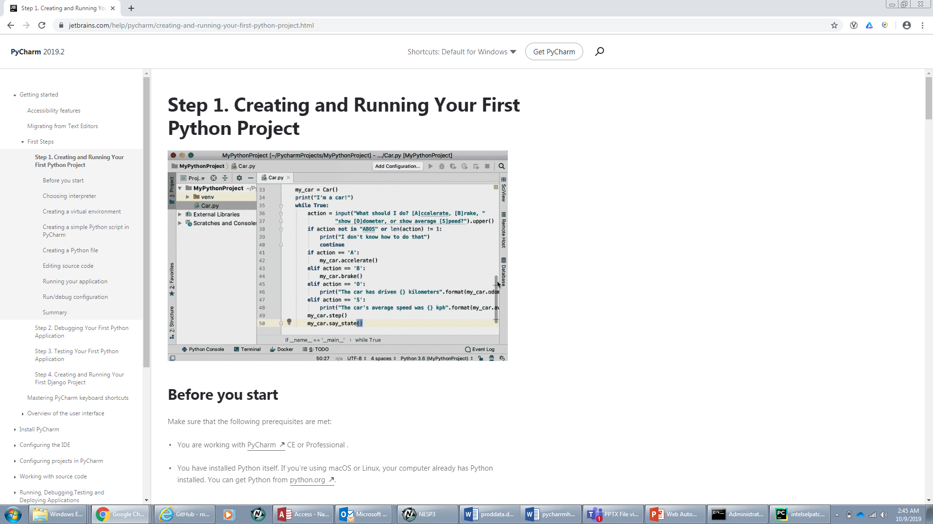
What is Python ?
- Widely used high-level programming language created in 1980’s
-Resembles the English language that computer can read
-Python Code has to read by interpreter
Download the interpreter from
Python files have a “.py” file extension
Image shows python coding without Selenium and Robot

Slide 5
Advantages of Python for testing Automation Software
Python is an ideal guideline for test automation.
Tests are readable and descriptive
There are several pre-defined frameworks that can be plug-in to Python.
Robot Framework is one of the frameworks that can be tied into Python
Python has a large selection of useful packages like Robot Framework, Selenium Webdriver, pytest, , unittest, and others that are available as off-the-shelf ingredients for custom automation recipes.
Python is object-oriented and functional. It allows developers to choose which is the one that best suits their needs.
There’s no need to “build” test code first because Python is an interpreted language, further simplifying execution.
Python’s low learning curve is great for beginner coders.
Python is one of the most popular programming languages in the world today It is a popular choice for Web developers, infrastructure engineers, data scientists, and test automation engineers.
It has a rich source of resources for learning and support in online web pages, in books, and tutorials.

Slide 6
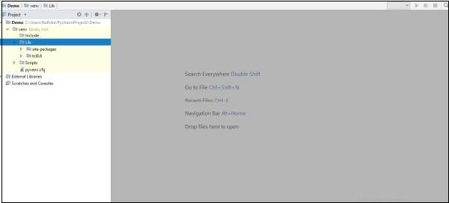
PyCharm IDE
PyCharm is created by Czech company, Jet brains which focusses on creating integrated development environment for various web development languages
Download the PyCharm Editor and official documentation at this link − https://www.jetbrains.com/PyCharm/
PyCharm is the most popular IDE for Python
Includes great features such as
Code Completion
SQLAlchemy as Debugger
Code Coverage in Editor
Package Management
Refactoring
User Interface of PyCharm Editor

Slide 7
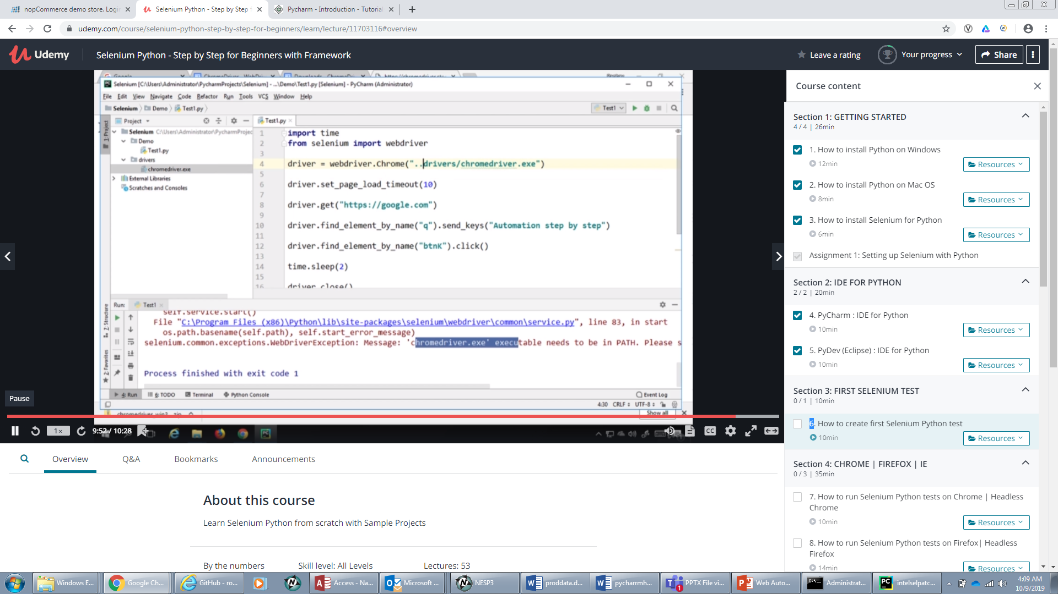
Python Selenium
Selenium is a tool to test your web application. You can do this in various ways, for instance
Permit it to tap on buttons
Enter content in structures
Skim your site to check whether everything is "OK" and so on.

Slide 8
Robot Framework with Python Selenium
Robot framework developed by Pekka Klarck, Janne Harkonean
Robot Framework is a generic test automation framework for acceptance testing
Acceptance test-driven development (ATDD)
It utilizes the key-driven testing approach
Provides test libraries implemented either with Python or Java
Users can create new higher-level keywords from existing one
Not much programming is required

Slide 9
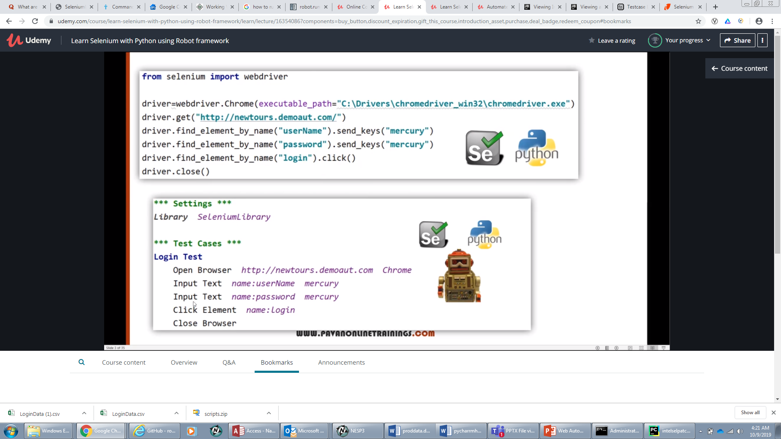
PyCharm code with just Python Selenium No Robot
Python Selenium code is easier then just straight Python coding at top
But using Robot Framework Library Keywords with Python Selenium is more user friendly at bottom.

Slide 10
Robot Framework with Python Selenium
PI
Robot Framework IDE
PyCharm
Robot Framework
Python Interpreter
PIP
DateTimeLibrary
Built-In Library
Etc.
Selenium Library
DBLibrary
WEB DRIVERS(Chome, IE, Firefox, etc)

Slide 11
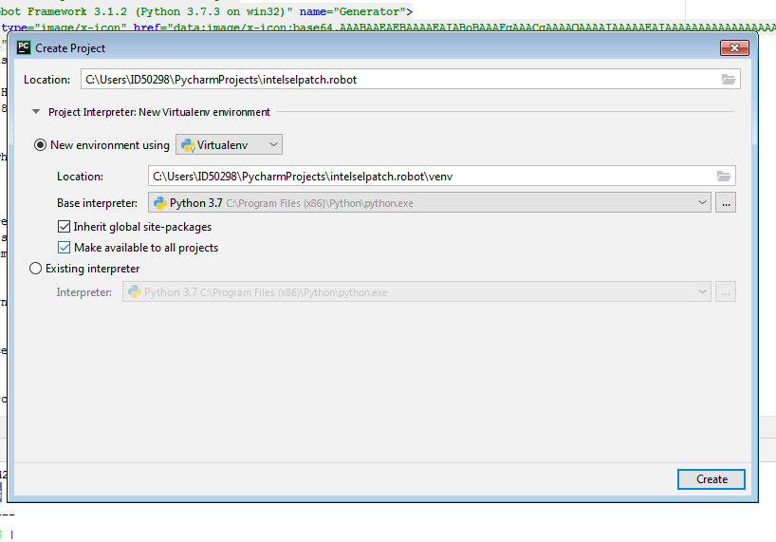
Create new Robot Framework Project
Click File Link>Click New Project
Enter project name with .robot extension
Click “New Environment using “Select Virtualenv”
Base interpreter is the path where you installed your folder
Click checkboxes beneath to use the global packages for your packages

Slide 12
Robot Framework PyCharm IDE
Left side shows Project File Structure for Robot Framework
There are 4 sections in the editor for Robot that you enter by starting to type the words in Editor.
Settings- Required
Under this section you include files, libraries, Test Suite commands
Variables -Optional
Create Variables to pass test case values to Keyword Functions
Test Cases - Required
Each Test Case starts with a name for the test case.
Python Keywords can be entered here to do key strokes, click links, open browser , etc.
Or You can enter your custom keyword to execute your actions on an element in the web page
Keywords –Optional
Create an inline script Keyword
Create a resource file to store custom Keyword

Slide 13
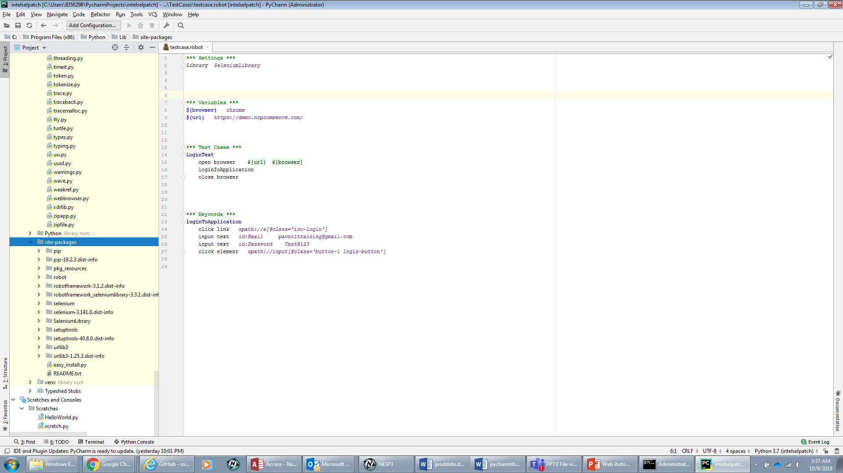
Robot Framework Creating a Test Case

Slide 14
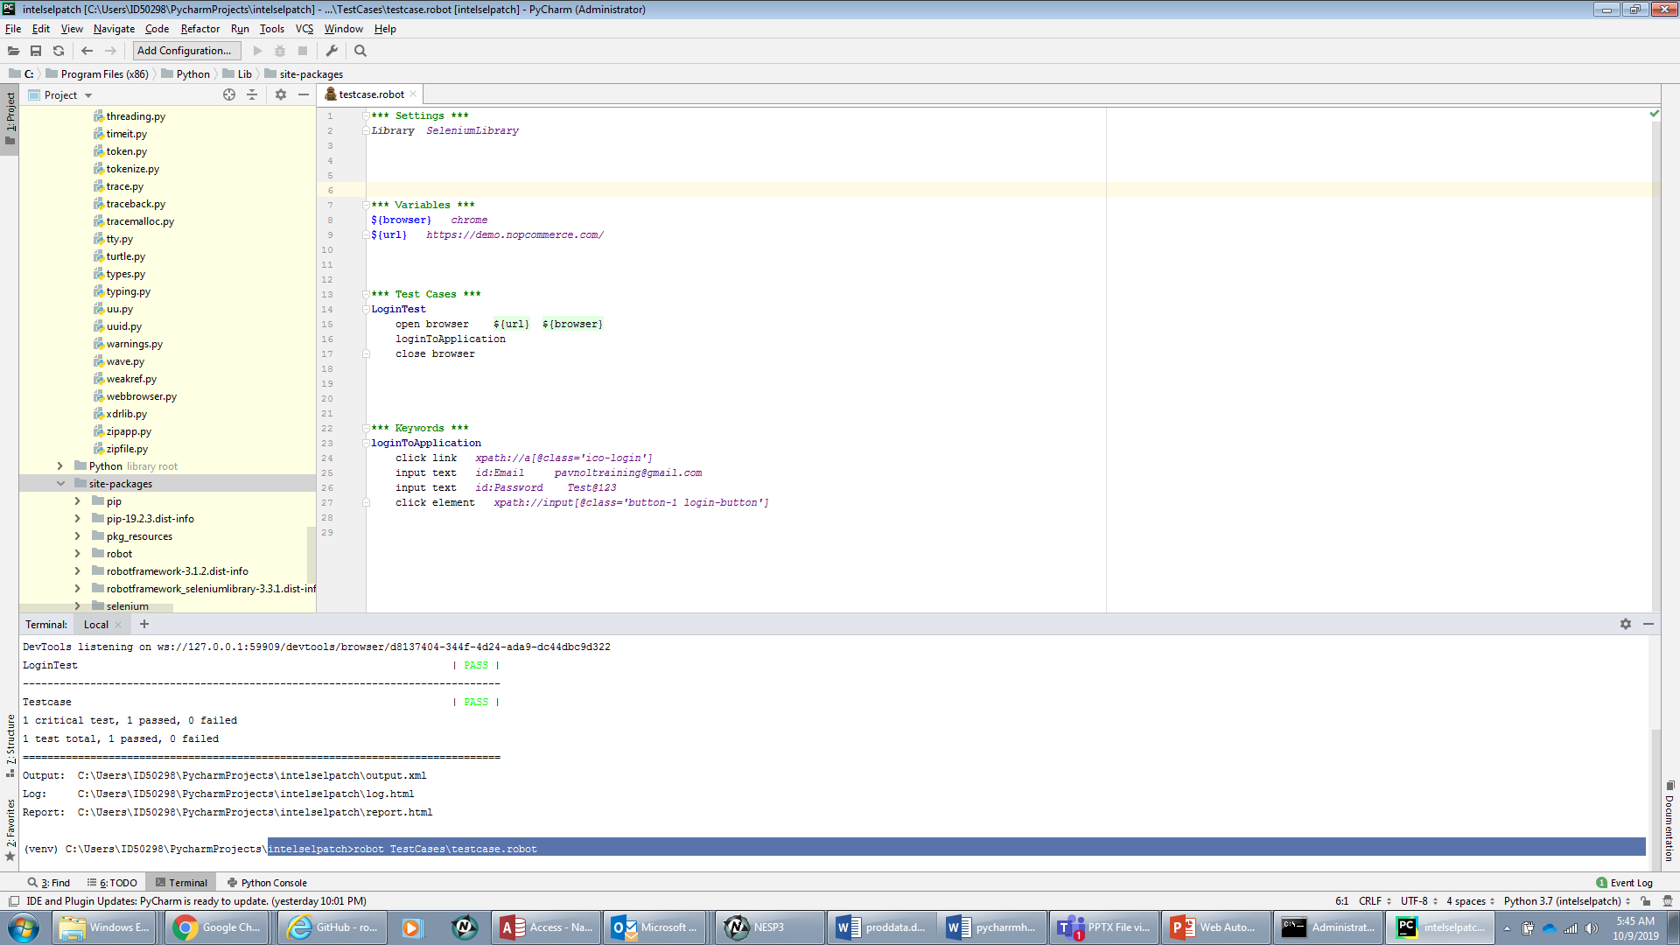
Robot Framework Terminal Execution

Slide 15
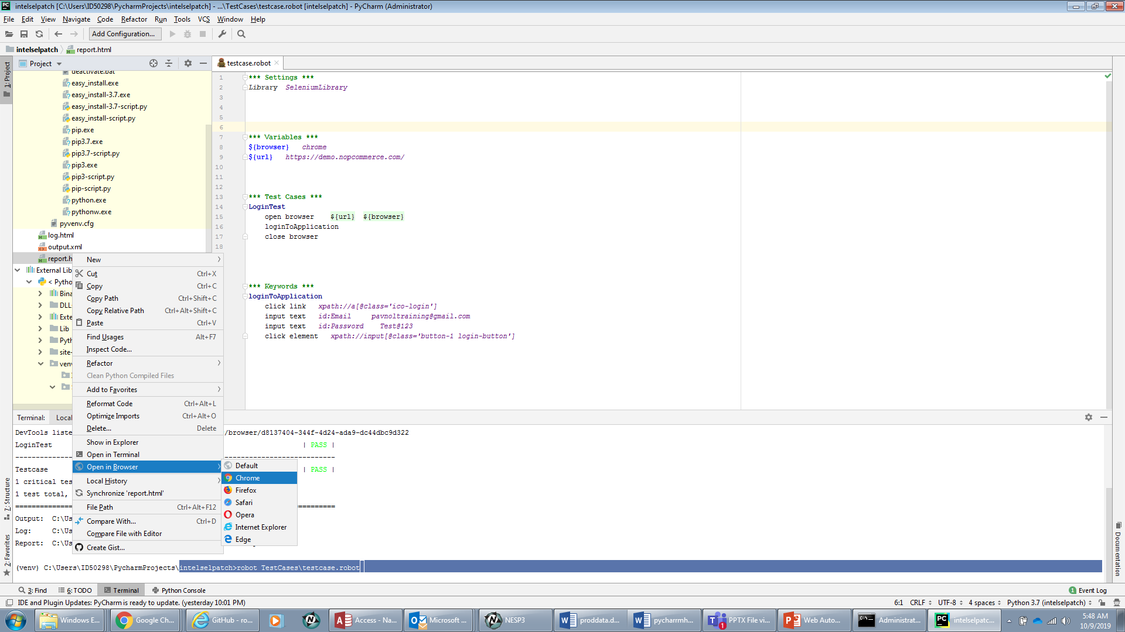
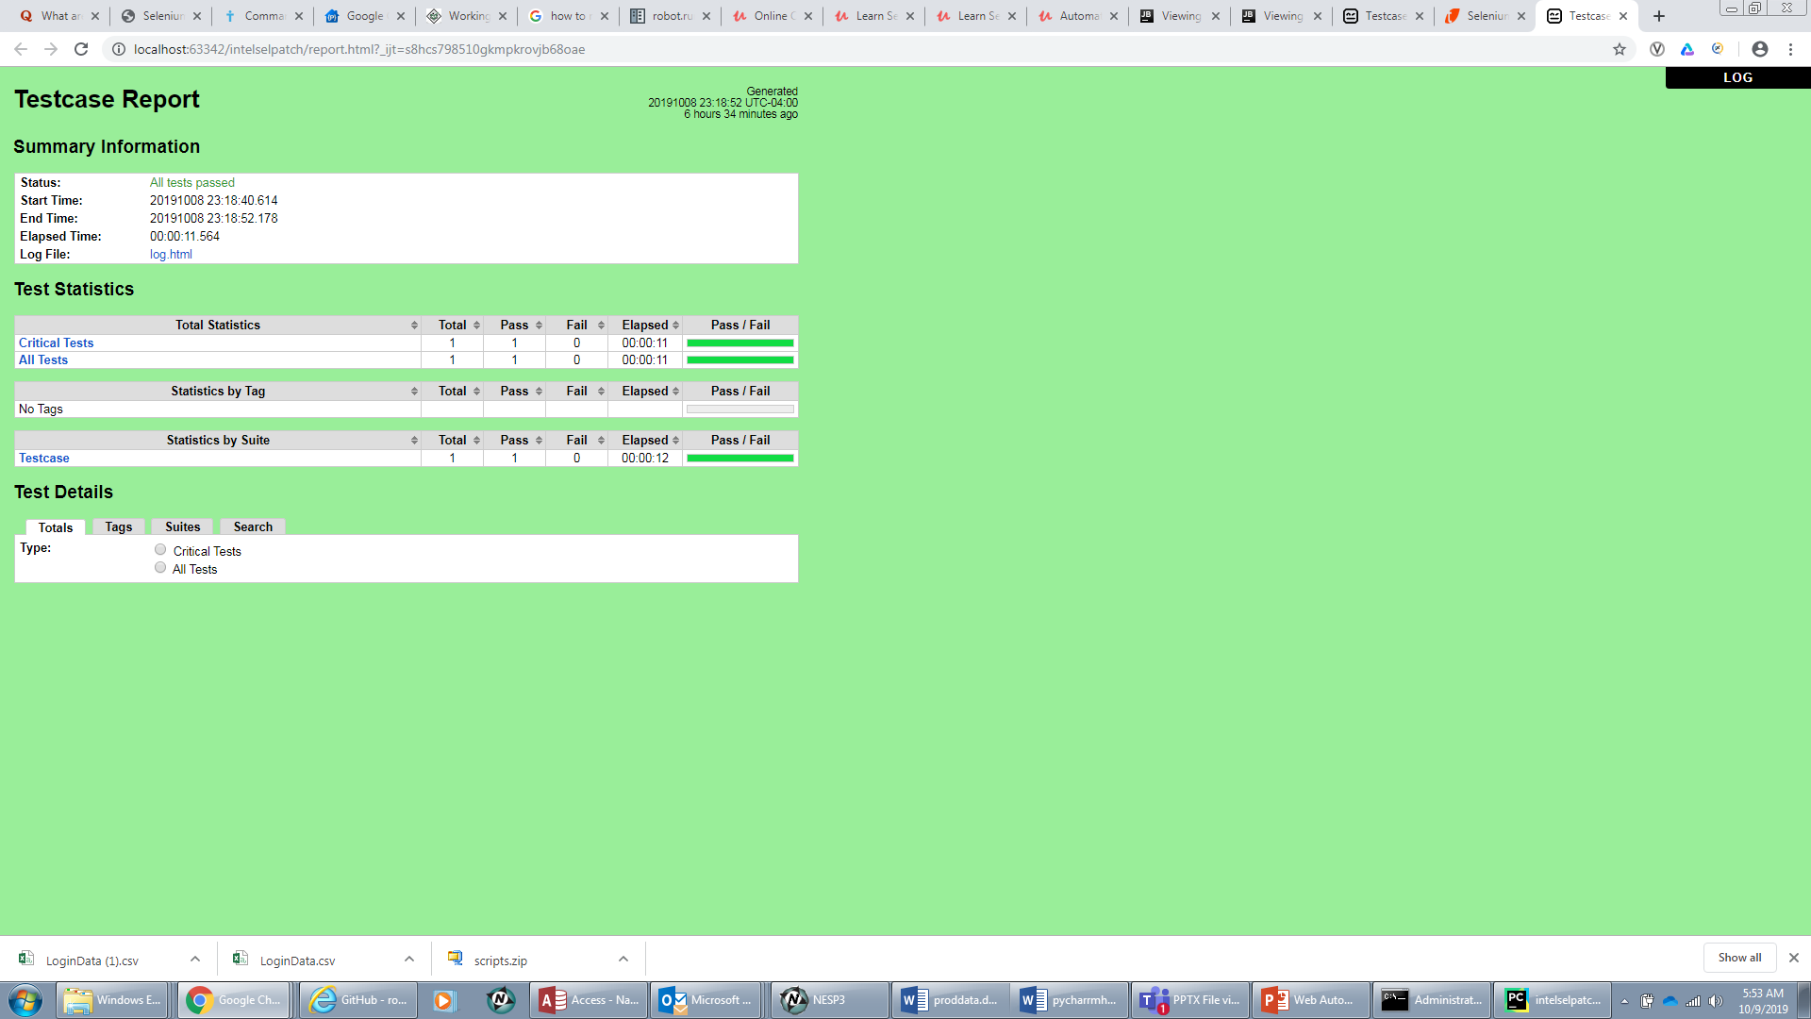
Robot Framework Test Execution Reporting

Slide 16
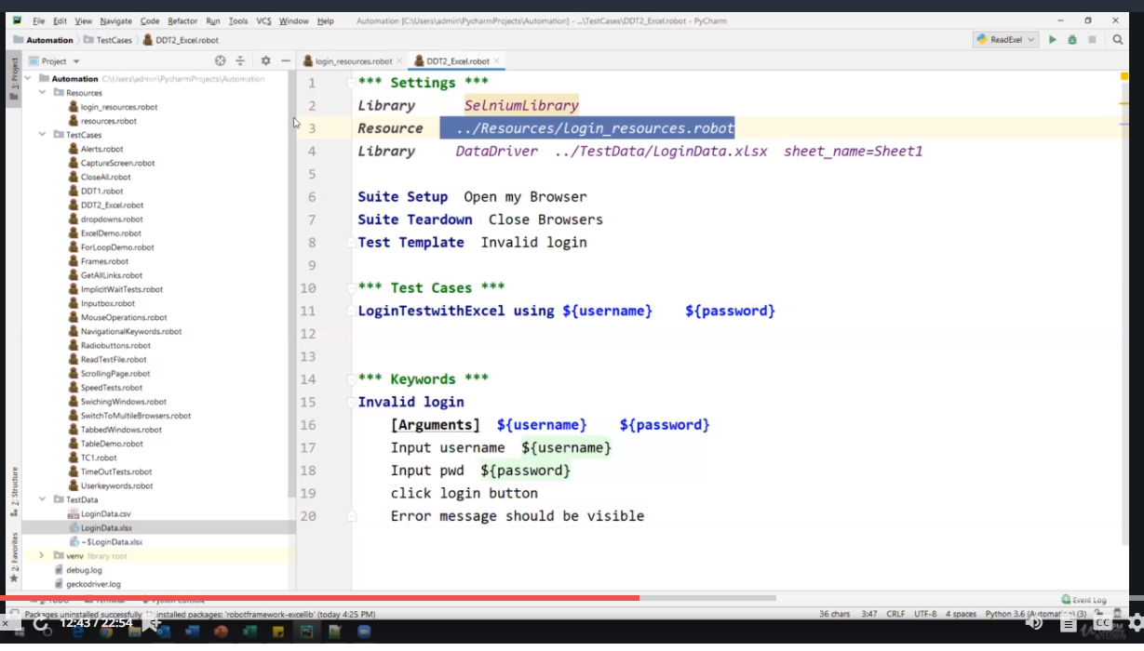
Robot Framework Test Cases using Data Driven Testing
Specify Test Data in the Script
Read Test Data in Excel File .xlsx
Read Test Data in CSV File .csv
Install Data driver Library

Slide 17
Robot Framework Data Base Testing
Install DatabaseLibrary & pymysql
*** Settings ***
Library DatabaseLibrary Library OperatingSystem Suite Setup Connect To Database pymysql ${DBName} ${DBUser} ${DBPass} ${DBHost} ${DBPort} Suite Teardown Disconnect From Database Library data
*** Variables ***
${DBHost} 127.0.0.1
${DBName} mydb
${DBPass} root
${DBPort} 3306
${DBUser} root
*** Test Cases ***
Update record in person table
${output}= Execute SQL String Update mydb.person set first_name="Jio" where id=104;
log to console ${output}
should be equal as strings ${output} None
Retrieve Records from Person Table
@{queryResults}= query Select * from mydb.person;
log to console many @{queryResults}

Slide 18
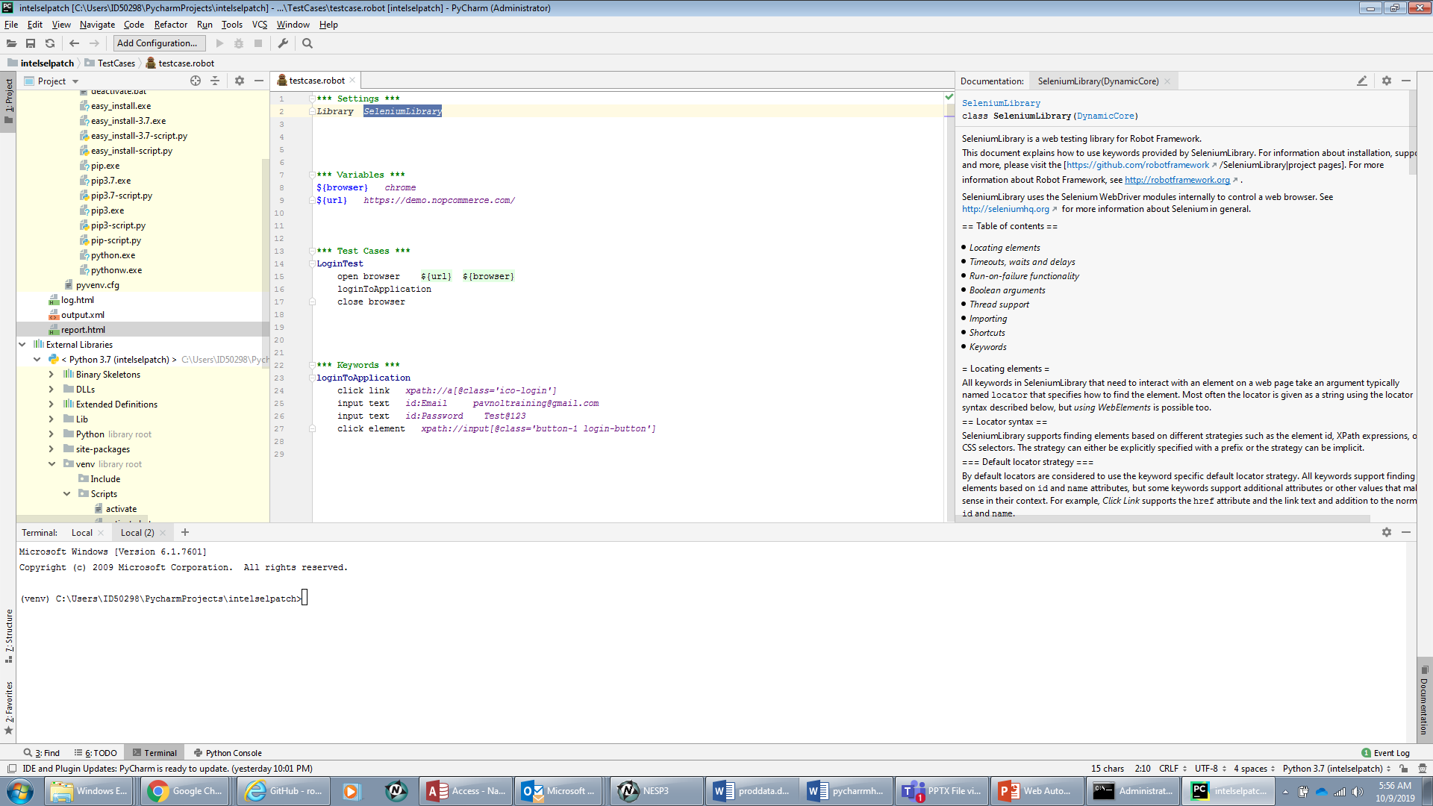
Access to Robot Framework Documentation
To access documentation on Robot Libraries and Keywords , press Ctrl + Q
after Highlighting the library

Slide 19
PyCharm/Robot Framework/Python Selenium Setup
Install Python
https://www.python.org/downloads/
Python 3.7.3
Installs also PIP 19.2.3 as well
Pip is used to install other libraries/packages
C:\Program Files (x86)\Python\Scripts is where the programs are I installed
This Path needs to be added to the Path definition for workstation
Check installation by going to “cmd run” and enter “python – version” at prompt and “pip –version” as well.
Download your web drivers to this folder also
Install PyCharm IDE
https://www.jetbrains.com/
Load down the community open source version of PyCharm

Slide 20
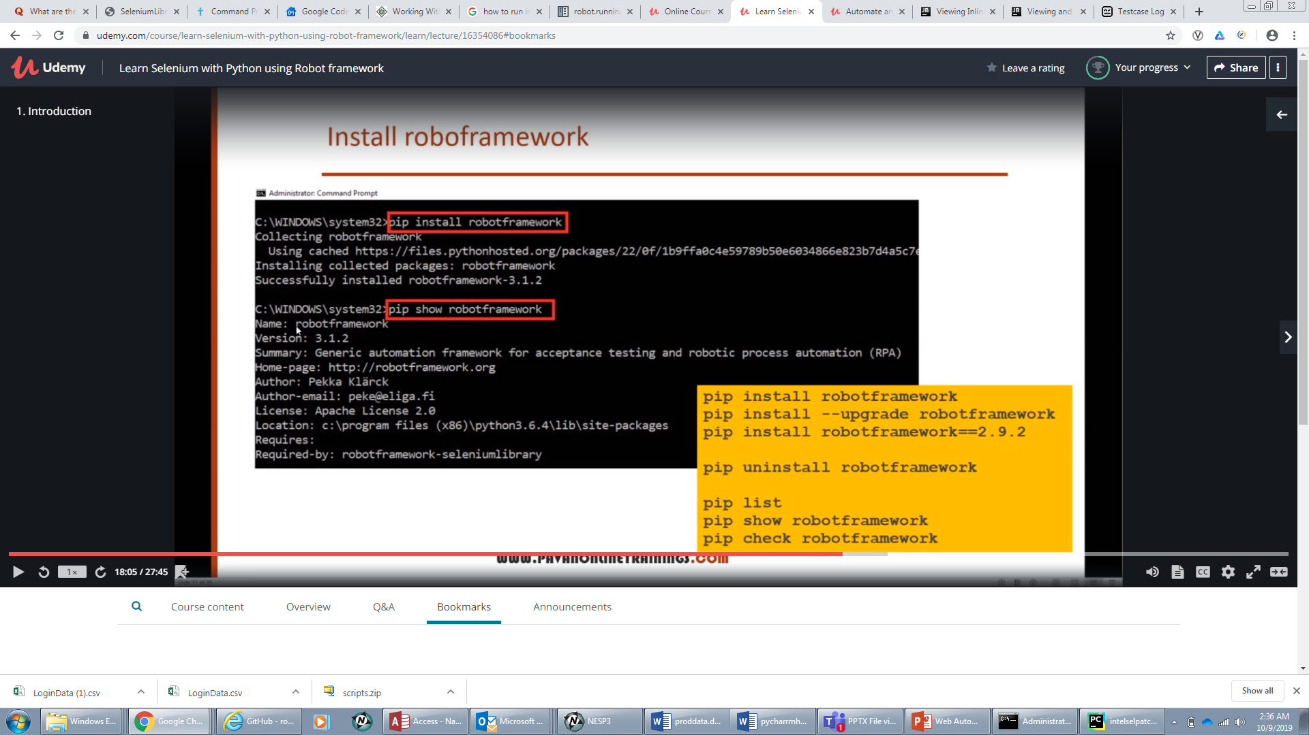
PyCharm/Robot Framework/Python Selenium Setup
Now install the 3 below packages using the PIP program
Install Selenium – “pip install selenium ”
Install Robot Framework –”pip install RobotFramework”
Install Robot Selenium Library”-
In PyCharm can also use the package manager to install libraries

Slide 21
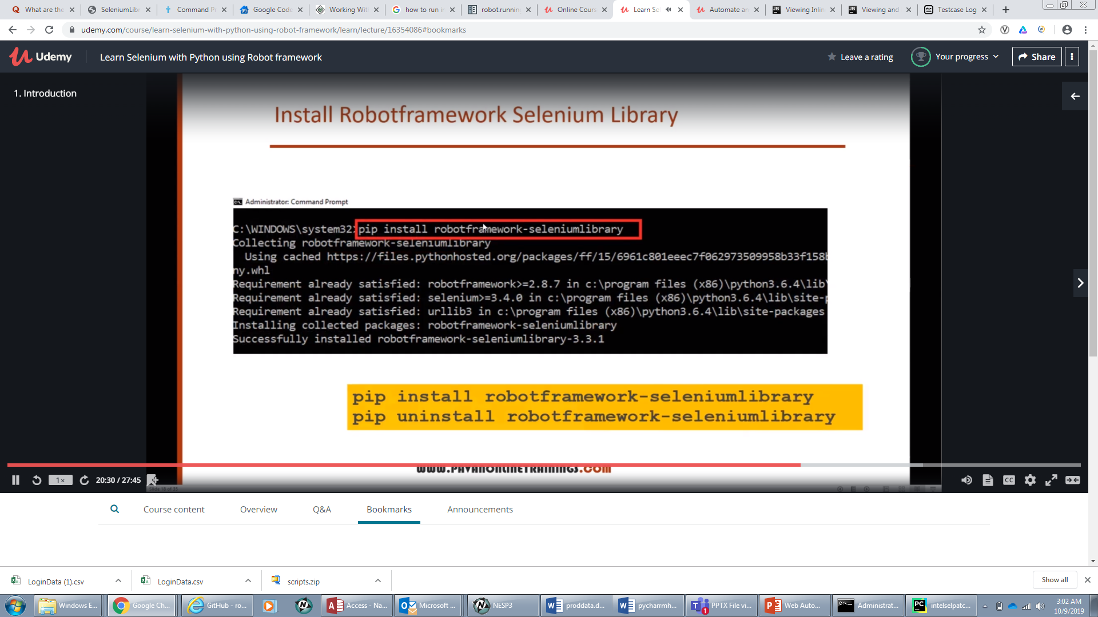
Install Robot Frame Work Selenium Library

Slide 22
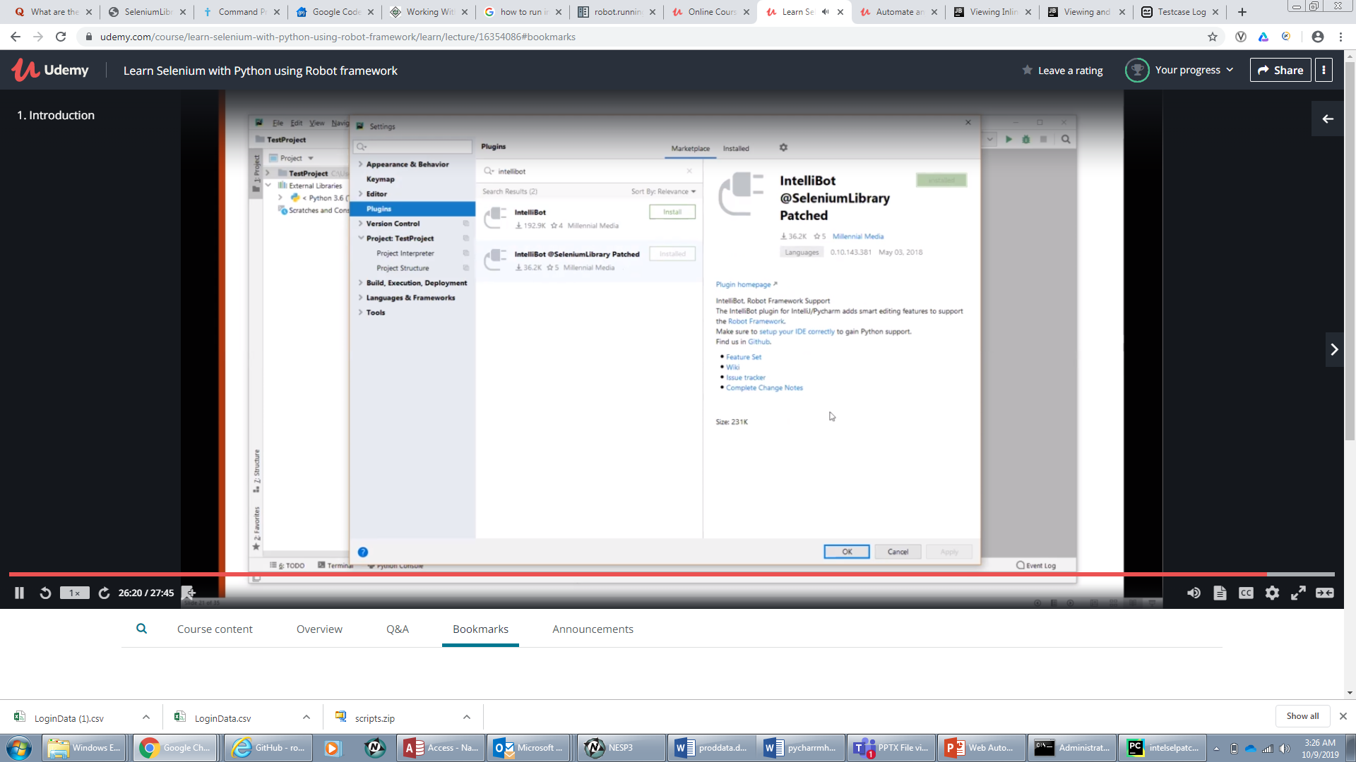
Robot Framework with Python Selenium
Add new Intellibot Selenium Library to Python(not just your project) with Plugin under PyCharm Settings

Slide 23
Questions?

